Slide 1
EDES 301 Smart Checkers Mechanism
02/23/2025
Mert Culcu

Slide 2
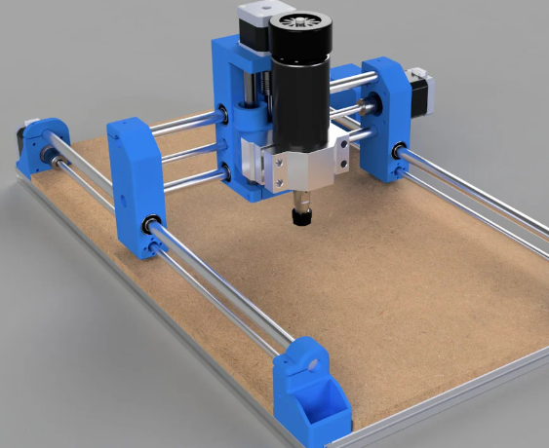
Background Information
I grew up playing strategy games like chess, checkers, backgammon, etc. I wished I could play these games in real environment if I don’t have someone to play with me. This motivated me to create a system that I can use mechanical, electrical and software skills to build a smart, embedded mechanism.
This mechanism uses a CNC-like understructure that can move in x,y and z coordinates.
https://www.thingiverse.com/thing:3004773 Author: NikodemBartnik

Slide 3
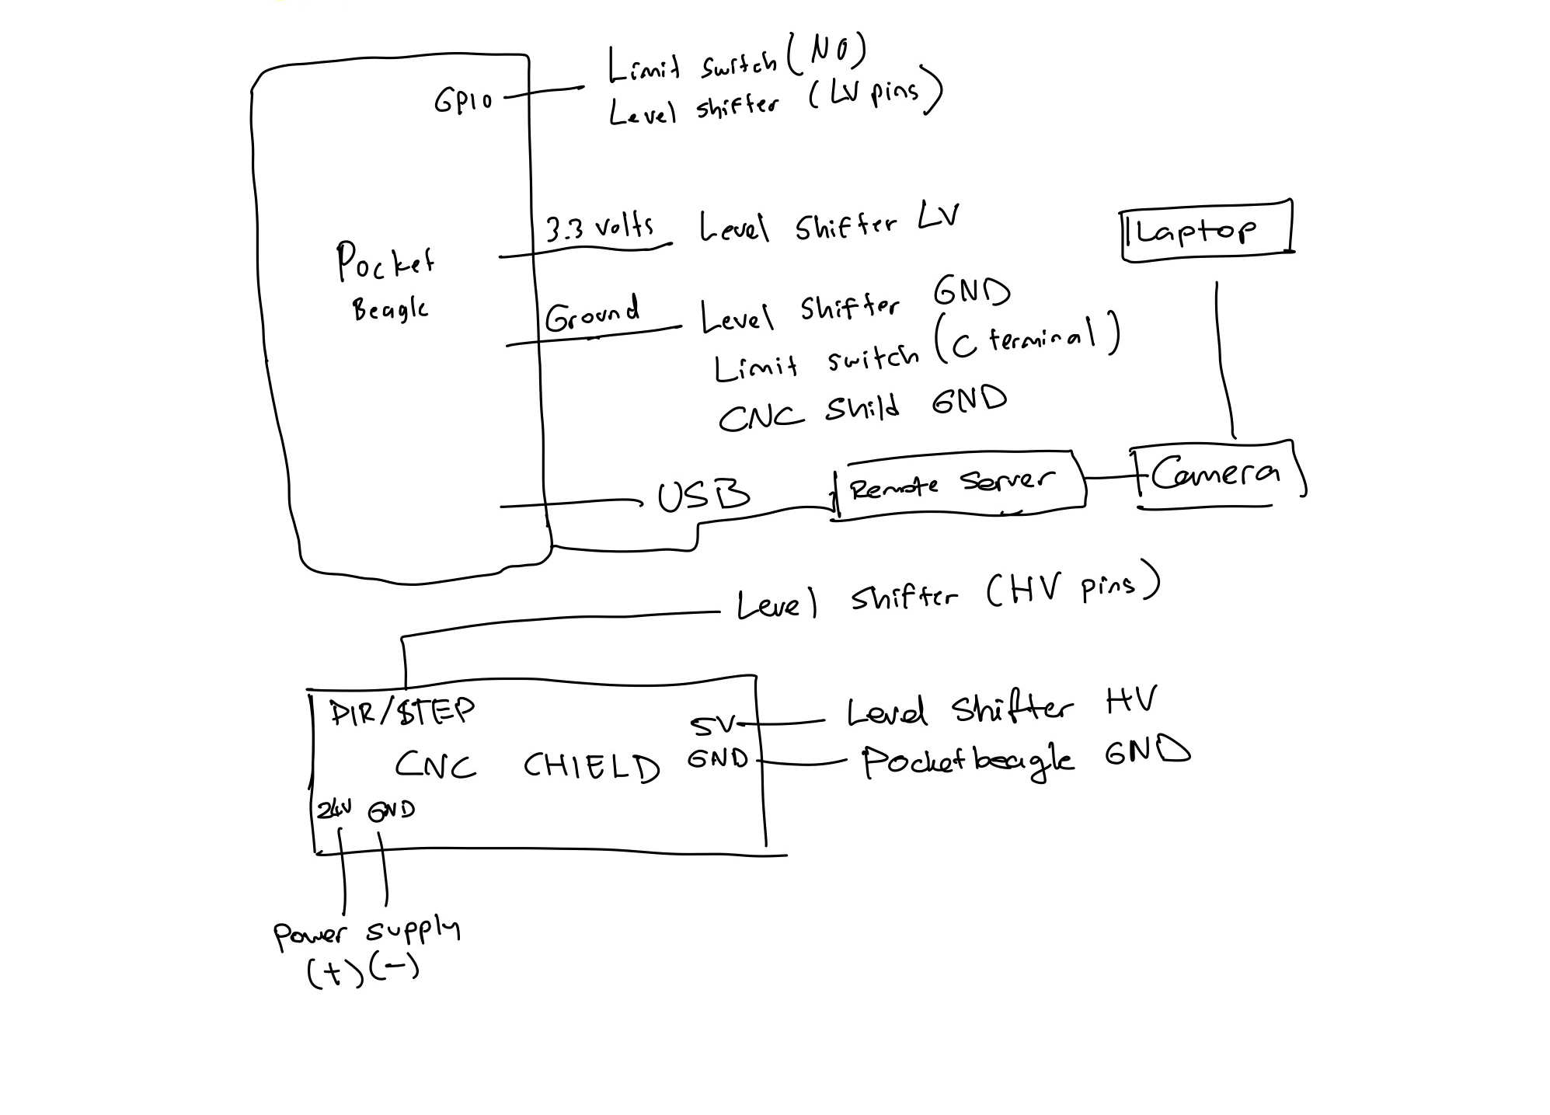
System + Power Block Diagram

Slide 4
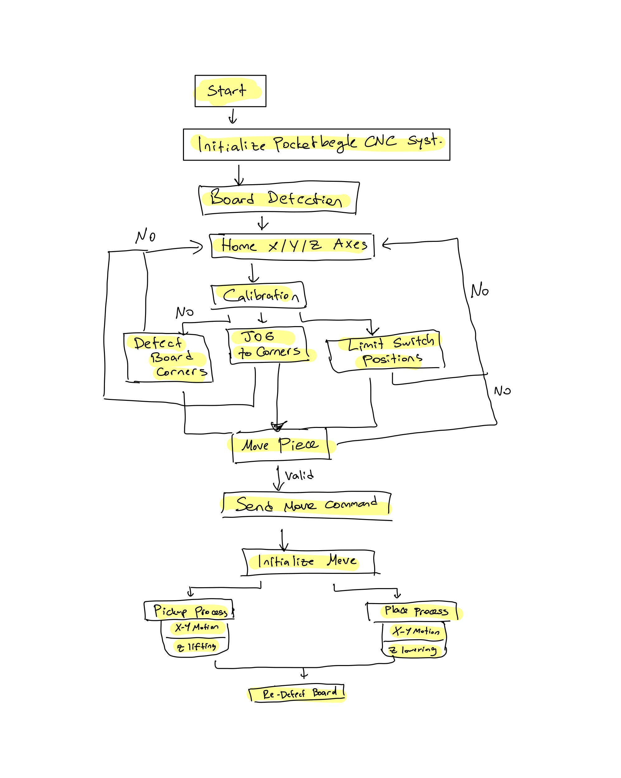
Software Diagram

Slide 5
Components / Budget
Electrical Parts:
1- Power Supply
2- Voltage Regulator
3- CNC Shield
4- Level Shifters
5- Motor Drivers
6- Stepper Motors
7- Limit Switches
8 - WebCam
9- PocketBeagle
Mechanical Parts:
1- Checkers Board (Polywood Laser Cut)
2- Linear Motion Rods
3- Lead Screw
4- Linear Cylinder Bearings
5- Coupler
6- Aluminum Extrusions
7- 608 Bearings
8- Screws (M3, M4, M5)
9- 3D parts
Software:
1- Cloud9
2- VS Code
Misc:
1- 3M Magnets (For pieces)
2- Neodymium Magnets (For z-axis)

